Slide 1
Inversions

Slide 2
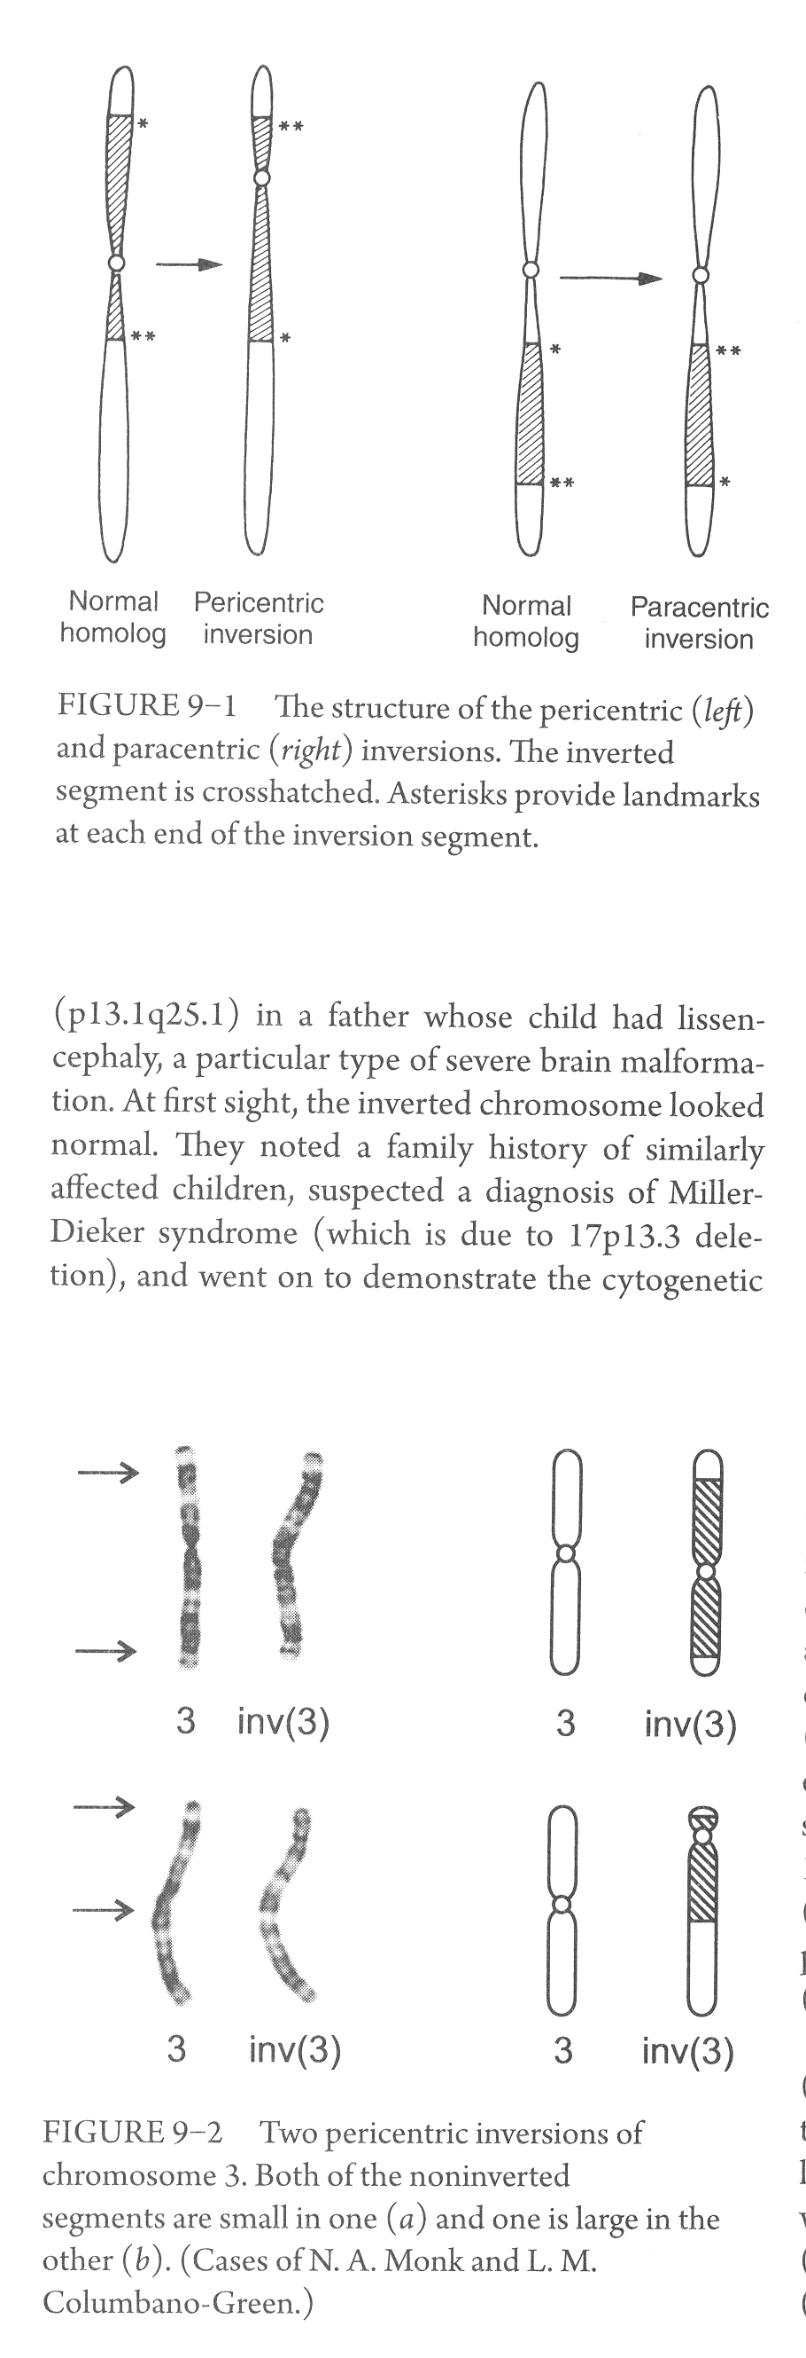
Examples:
46,XX,inv(3)(p25q21)
46,XX,inv(11)(q21q23)

Slide 4
The clinical relevance of inversion chromosomes is that they can set the stage for the generation of recombinant gametes that may lead to abnormal pregnancy
The chromosomal imbalance is a result of the formation of a recombinant chromosome, which occurs if there is, within the inverted segment, a crossover between the inversion chromosome and the normal homolog
As with other balanced chromosome rearrangements, inversions will not be detected by chromosome microarray. When a balanced rearrangement is suspected a classical microscope karyotype is required

Slide 5
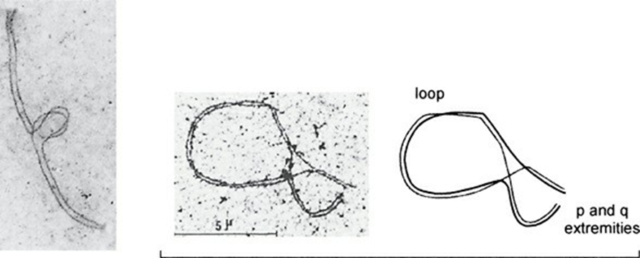
FIGURE 9–3. Inversion loop in meiosis, direct observation. Left, inversion loop in a mouse study. Right, spermatocyte study of a man with inv(6)(p22q22.2).
Classically, crossing-over follows the reversed loop model. This configuration of the bivalent at meiosis allows as complete as possible alignment and pairing of matching segments of the inversion chromosome and its normal homolog (homosynapsis)

Slide 6
When a crossover happen in the inverted region, one of the chromosomes will have duplication of the distal segment of the short arm, and a deletion of the distal segment of the long arm
And the other way around in the other chromosome

Slide 7
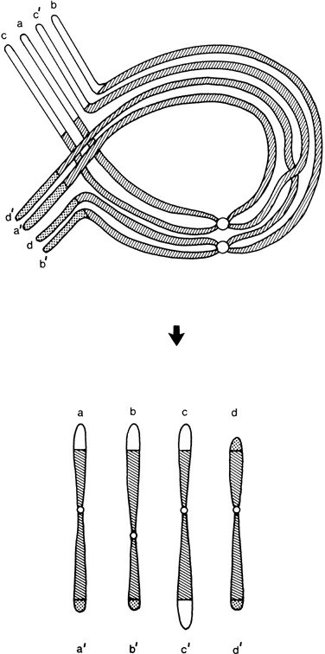
FIGURE 9–4. Inversion loop in meiosis, theoretical recombinant outcomes. Both sister chromatids are shown. The inversion (centromeric) segment is cross-hatched, the long arm noninverted segment is stippled, and the short arm noninverted segment is open. The four possible gametic outcomes following one crossover within the inversion loop are depicted. Chromosomes a-a′ and b-b′ are the intact homolog and the inversion, respectively; chromosomes c-c′ and d-d′ are the dup p and dup q recombinant chromosomes.

Slide 8
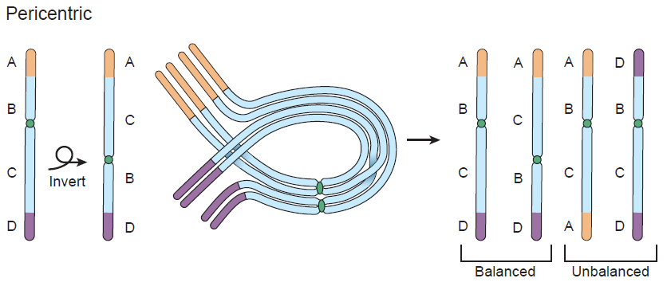

Slide 9
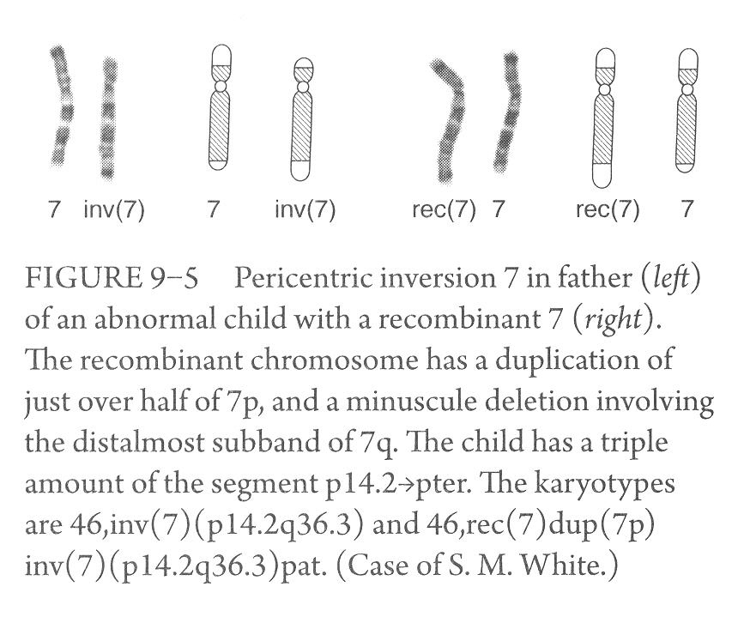

Slide 10
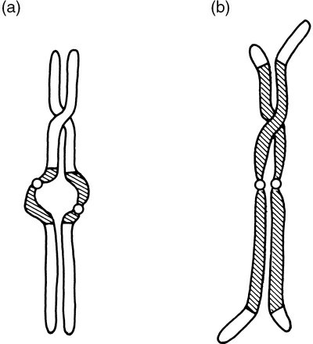
FIGURE 9–6. Alternative models for meiotic pairing, in which only a partial synapsis is achieved. Synapsis of (a) both distal segments; (b) the inverted segment. One crossover is shown in each.
Short inverted segment, “balloon out” (asynapsis of the inversion segment) or lie adjacent but not matched (heterosynapsis). No crossover can happen within inverted segment, and recombinant products do not form
Long inverted segments may synapse the inverted segments only, with distal ends unpaired. Recombination can occur

Slide 11
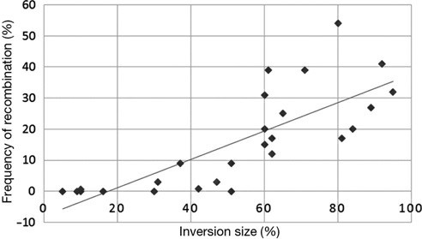
FIGURE 9–7. The proportion of gametes that are recombinant, compared with the relative size of the inversion. Individual data points and the regression line are shown. The clear trend is that the larger the inversion size, the more frequently recombinants are seen.
No risk small risk high risk
Sperm studies in a small number of inversion heterozygotes give an indication of the frequency with which recombination happens, at least in male gametogenesis
These several studies show that the longer the inverted segment, the more likely is recombination to happen. Presumably, a longer inverted segment allows a more ready formation of an inversion loop.

Slide 12
Paracentric inversion
Classically, heterozygote for an autosomal paracentric inversion will only have children who are karyotypically normal, or with the same balanced inversion
They cannot have viable unbalanced progeny
If a recombinant gamete is formed following a crossover
in the inverted segment, the chromosome would be either acentric or dicentric

Slide 13
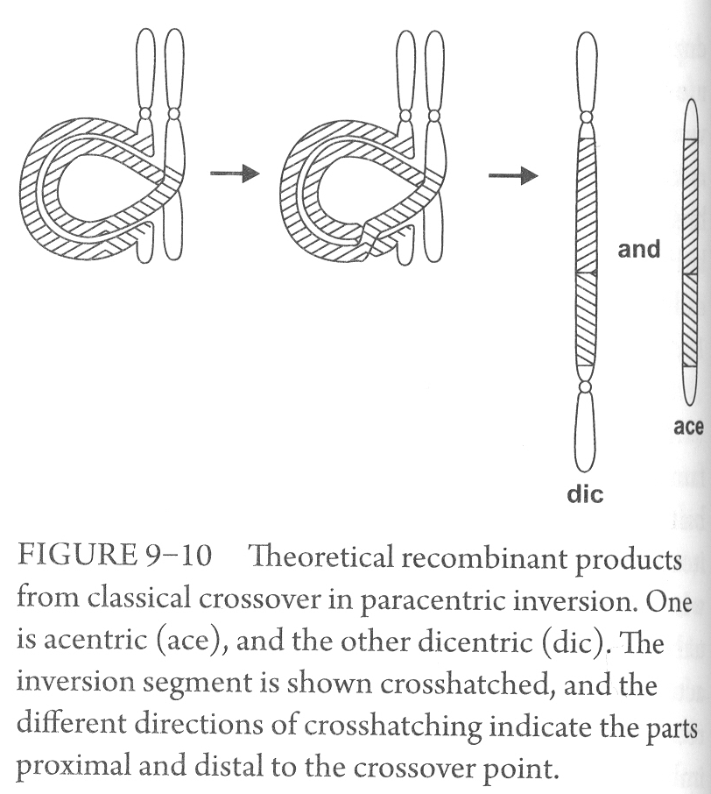

Slide 14
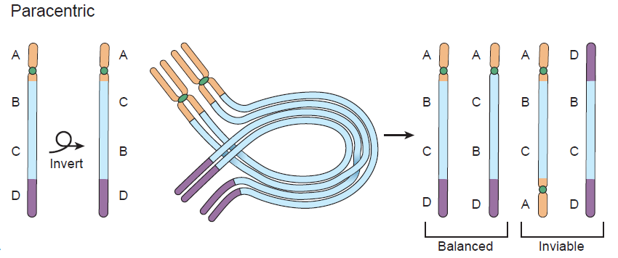

Slide 15
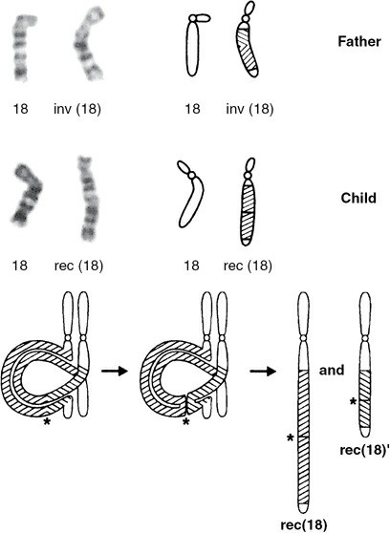
Exceptions to the classic theory; The abnormal process of “U- loop recombination”
FIGURE 9–13. Above, parent with paracentric inversion and child with recombinant (“reunitant”) chromosome. Father has paracentric inversion of 18q, inv(18)(q12.1q23). The inverted segment is shown cross-hatched (cross-hatching changes slope at q21.3). Child has duplication of the segment q12.1q21.3 on the reuniting chromosome (shown cross-hatched) and deletion q21.3q23. Below, Proposed mechanism of U-loop exchange depicted; asterisk indicates point of U-loop. The position of the point of exchange within the inversion loop (in this case, q21.3) determines the nature of the imbalance. There is duplication of chromatin proximal to the crossover point (q12.1q21.3), and deletion of distal chromatin (q21.3q23), as in the child’s rec(18); and vice versa in the complementary product, rec(18)′.
Recombination/reunion with viable products
U-loop recombination resulting in reunitant (recombinant)
Chromosome would have either a duplication of that part of the inversion loop proximal to the crossover, and a deletion of that part distal to it; or vice versa

